Slide 1
Stepping Out Of The Diet Trap
Jason Lillis, PhD
Brown Medical School

Slide 2
Notes:
Body Gratitude: Body tries to provide, find balance, no matter what you do: Wisdom
Heartbeat, pumping, blood, served you, climb stairs or run, rests when sitting: Thank
Stomach, digestive tract, sorting out, dealing with all manner of inputs, using what can, discarding what can, putting up with all your diets/changes, no judgment, just works for you best it can
Brain, marvel, billions of neurons, coordinating, working, sorting, sending information, works so fast we don’t even understand: Evolved for other purposes, doing it’s best- notice enormity of the job it’s been giving: extended gratitude
Notice what acts of self-compassion feel like in your body- sit with that
Comfortable, uncomfortable?
Our relationships with our body- so complex
Part of what’s happening, overweight and obese come to hate their bodies, and as an extension, themselves- can feed a comfort/ avoidance cycle, coupled with the environment and physio changes, makes it very, very hard to lose and maintain weight

Slide 3
Prevalence* of Self-Reported Obesity Among U.S. Adults BRFSS, 2012
7% → 5% → ??
15%–<20% 20%–<25% 25%–<30% 30%–<35% ≥35%
Notes:
% obese continues to grow
We seem to have exported to rest of the world
Everything we know about physiology = body will act likes it’s starving and persist, we are not sure how long, probably permanently until will find pharmacological solutions
7% Weight Loss , 6 months
5’4” 200lb (34 BMI) -> 186lb (32 BMI)
At 1 year, half at less than 5%
LookAHEAD
8.5% at 1YR, 6% End,
no reduction in heart disease risk

Slide 4
And yet prevailing wisdom is…“We know”
…What if this were another area?
Notes:
NWCR: This is what works, do this
Owning successes, but not failures (“non-adherence”)

Slide 5
Assumptions
Notes:
How do you react to non-adherence?
Person failure or treatment failure
The field has chosen “person failure”
Generalizes from a few to many (NWCR)

Slide 6
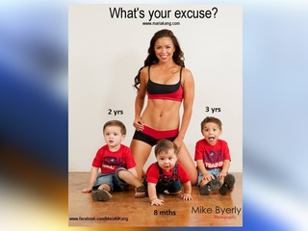
Stigma
Work
Education
Family/Friends
Social Settings
Medical Settings
Notes:
Some notes on stigma
Obesity seen as controllable, personal weakness
Stupid, lazy, weak, undesirable
Stigma is a likely feeder of Experiential Avoidance, which we know is not great

Slide 7
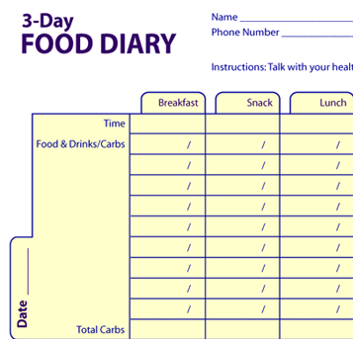
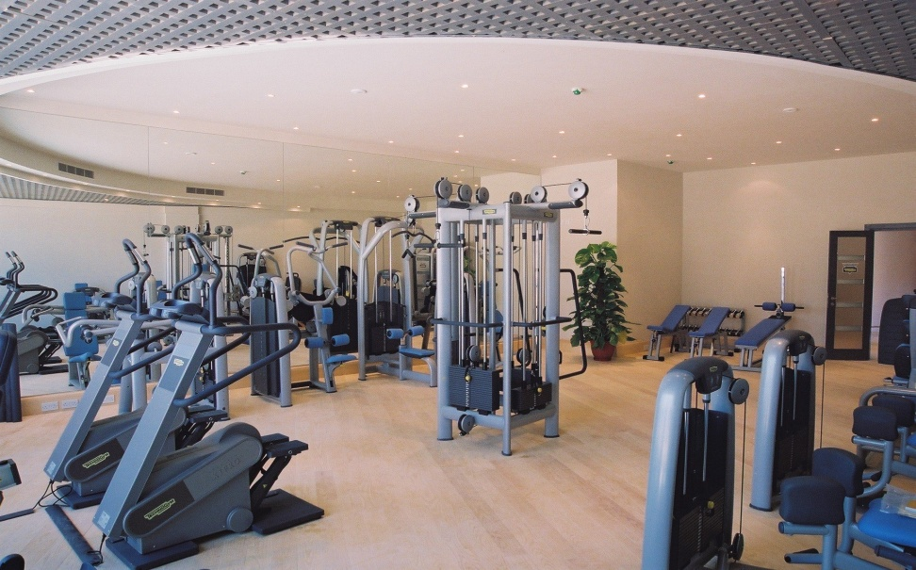
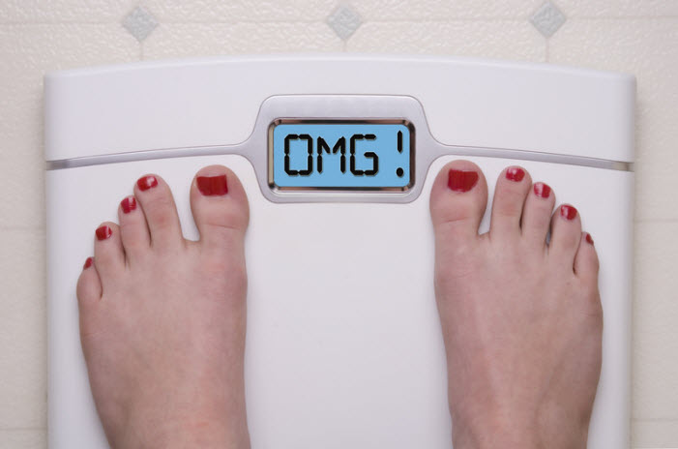
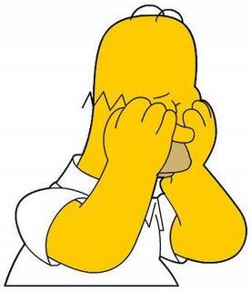
“You’re disgusting!”
I’m fat, ugly, unlovable
SHAME
Notes:
How this shows up in weight management
So we have our poor man here who’s been exposed to scorn and ridicule for his weight, which leads to uncomfortable thoughts and feelings
Given that we live in a stigmatizing environment, he will have considerable exposure, when you take into account that bias against overweight starts at age 3, obese people get paid less for the same job, not to mention are hired and promoted less, and you can’t escape disparaging portrayals on TV, the internet and in the media
These thoughts and feelings can come to be associated with countless situations and events which have nothing to do with receiving scorn or ridicule directly, again because of the two features of language we discussed.
Now let’s say our man overeats at a party. In order to avoid having these unwanted thoughts and feelings, he might find himself, say, not recording in his diary, because recording all that food he eat could lead to those unwanted thoughts and feelings. Or perhaps he now has to avoid the gym, so that nobody (him included) can see his body in motion. Or perhaps put that scale away, because weight gain, or no loss, or not “enough” weight loss can all come to occasion those unwanted experiences.
Language never stop extending the targets of avoidance

Slide 8
Exp Avoidance and Weight
EA moves toxic to weight control
Emotional/Binge/Stress Eating
Discontinuation of diet/ tracking
Scale/ exercise avoidance
“Work” in the short-term
What if we could target all at the same time?
EA not on the radar current best practice (SBT)
Notes:
So EA does appear to be relevant to weight issues, which makes logical sense, because a lot of behaviors that are toxic to weight control can be conceptualized as experiential avoidance moves, for example:
(1) emotional, binge, or stress eating, that seem to function at least in part to change or reduce negative affect.
(2) Discontinuing diet or tracking to manage guilt and shame
(3) Avoiding the scale or exercise to avoid the physical sensations and self-judgments associated with these activities
-All these behaviors tend to “work” in the short-term by providing comfort, relief, or escape…even though they create more “problems” in the long-term

Slide 9
ACT vs SBT
A priori goals
Weight loss
Motivation to lose weight
Feeling better, looking better, “confidence,” “sexy,”
Function vs topography
No exercise: problem solving vs avoidance
Emphasis on private experiences

Slide 10
Potential benefits of combining
Values
Increasing buy-in, expanding meaning
Acceptance and Defusion
Cravings, persistence
Mindfulness
Planning, food choices, slow eating
Stress/ psychological symptoms

Slide 11
Potential obstacles
Overarching treatment goal
Weight loss vs valued-living
Structural
Weighing at groups- message scale is most important

Slide 12
Potential obstacles
Well-trained habits vs mindful awareness
Teaching repetition vs intuition/ flexibility
Weight Loss as Experiential Avoidance
Motivation to think different and feel better about self- can be a trap

Slide 13
Data

Slide 14
Weight Maintenance
84 participants – had previously completed 6 months of weight loss intervention
1 day ACT workshop vs TAU Control
3 Month Follow-Up
*No weight influencing interventions
Notes:
14
Absolutely nothing focused on self-monitoring, exercise, or diet. Nothing.

Slide 15
Pre to Follow-Up Weight Change
3 month follow-up
p < .001
d = 1.21
35
30
25
20
15
Control
10
ACT
5
0
% gaining 5+ lbs
% losing 5+ lbs
Changes (decreases) in experiential avoidance mediated outcomes.
Lillis, Hayes, Masuda, & Bunting, Annals of BMed, 2009
Notes:
*Keep in mind, we taught no strategies for weight loss. None.

Slide 16
Pre to Follow-Up Binge Eating (Lillis, Hayes, & Levin, 2011, BehMod)
3 month follow-up
p < .05
2.0
1.5
1
Control
ACT
0.5
0
Baseline Binges
Follow-up Binges
Notes:
-EDE-Q Questions but asked as a weekly average.
*NOT TARGETED!

Slide 17
ABBI Open Trial
20 adults, 2 groups
Non-randomized
ACT + SBT combined
6 months of weekly treatment

Slide 18
Expected
Niemeier, et al, BT, 2012
Notes:
-Pilot; 2 groups, non-randomized (N=21); High Internal Disinhibition; 6 Months
-Combined program SBT + ACT
-Checked our databases and typical weight loss is only 8kg
-Roughly 50% more than was expected
-And better yet, maintained over the 3 month follow-up

Slide 19
ABBI R01 Study (RCT; ongoing)
1 year treatment (weekly then tapered)
SBT Basics for 4 weeks
ACT mixed in throughout thereafter
Heavy values, defusion, acceptance
Focus specifically on defusion and acceptance related to weight management
Some more formal mindfulness later, including urge surfing and mindful eating

Slide 20
Weight Loss
Loss in kg
11
10
9.7
9.4
9
8.0
8.0
8
7
SBT
SBT
6
ACT
ACT
5
0
3 months
6 months
Notes:
Heather’s pilot had 12kg loss at 6 months

Slide 21
Data Summary
Overall very positive
Drexel group

Slide 22
What we know and what we don’t…
…for who and what?
…combined or something new entirely?

Slide 23
Clinical Examples

Slide 24
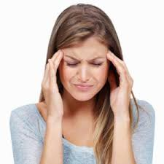
Internal vs External
Notes:
A pivot point
[Ice cream demonstration- Can use candy bar (assortment of sweets)]

Slide 25
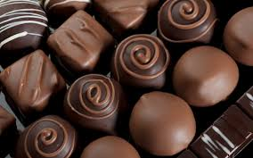
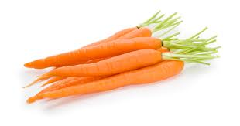
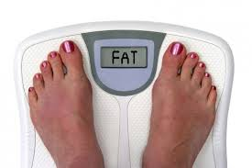
Defusion
“Only if”
vs.
“Even if”
Notes:
Worst motivational speaker
Only if vs even if [ask them to come up with the best examples]
Lying Scale
Chocolate vs Carrot [do in pairs]

Slide 26
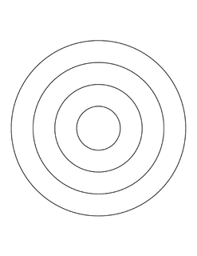
Acting with Willingness
“I must” vs. “I choose”
Notes:
Willingness pedometer [have them do own writing- group share]
I must vs I choose
Willing discomfort, what are you voting for?
Cost- Suffering circles what choosing/ what not choosing? [demonstrate]

Slide 27
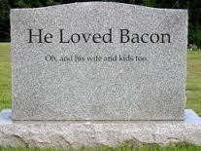
Values
Notes:
Weighing success by valued living
Do “pushing the play button” [write then share in 3’s]

Slide 28
Being Seen
Notes:
Looping back, world is cruel, but our attempts to shield ourselves from the world come at a cost – part of what ACT can bring is busting through this

Slide 29
END

